Slide 1
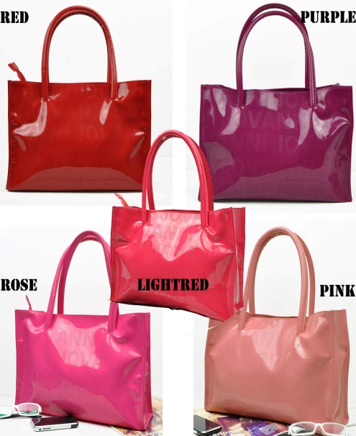
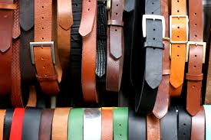
Online leather shopping

Slide 2
SUBMITTED BY:-
NAME ROLLNO
BASUDEOMAHATO 13000213065
SUBHAM SOURAV 13000212051
SANJAY RAWAT 13000213068
SUMODEEP GHOSAL 13000212055

Slide 3
Introduction
Online leather shopping or e-shopping is form of electronic commerce which allow consumers to directly buy goods or service from a seller over the internet using a web browser.
Alternative name are e-web store ,e-shop ,Internet shop
An online leather shopping system that permits a customer to submit online orders for items and/or services from a store that serves both walk-in customer and online customers.
The online leather shopping system present an online display of an order cutoff time and an associated delivery window for items selected by the customer
The online leather shopping system does not settle with credit supplier of the customer until the item selected by the customer is picked from inventory but before it is delivered.

Slide 4
Feasibility Study
Feasibility study is the second phase of the System Development Life Cycle. But in wide séance , feasibility study is a cross life cycle activity and should be continuously performed throughout a system project
Stages of Feasibility Study
Operational feasibility
Technical feasibility
Schedule feasibility
Economical feasibility

Slide 5
Requirement Analysis along with Software and Hardware specifications:- SOFTWARE SPECIFICATION
Operating system : windows 8
Application software : eclipse, JDK 1.8
Server : apache tomcat 7.0
Database : oracle database 10g express edition
Technology : J2EE

Slide 6
HARDWARE SPECIFICATION
Computer :- PC,Laptop
Processor :- intel pentium dual core
RAM :- 2GB
Input Device :- Mouse,Keyboard
Output Device :- Printer,Moniter
FOR CLIENTS
Web Browser like Microsoft Internet Explorer, Google Chrome Mozilla Firefox etc.

Slide 7
SNAPSHOTS

Slide 8
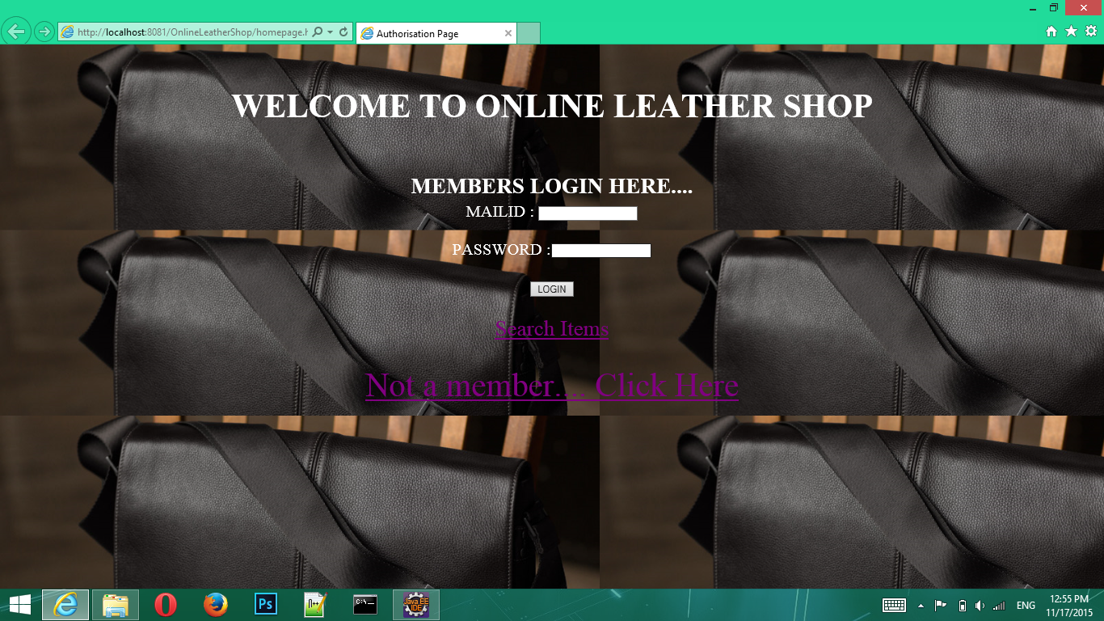

Slide 9
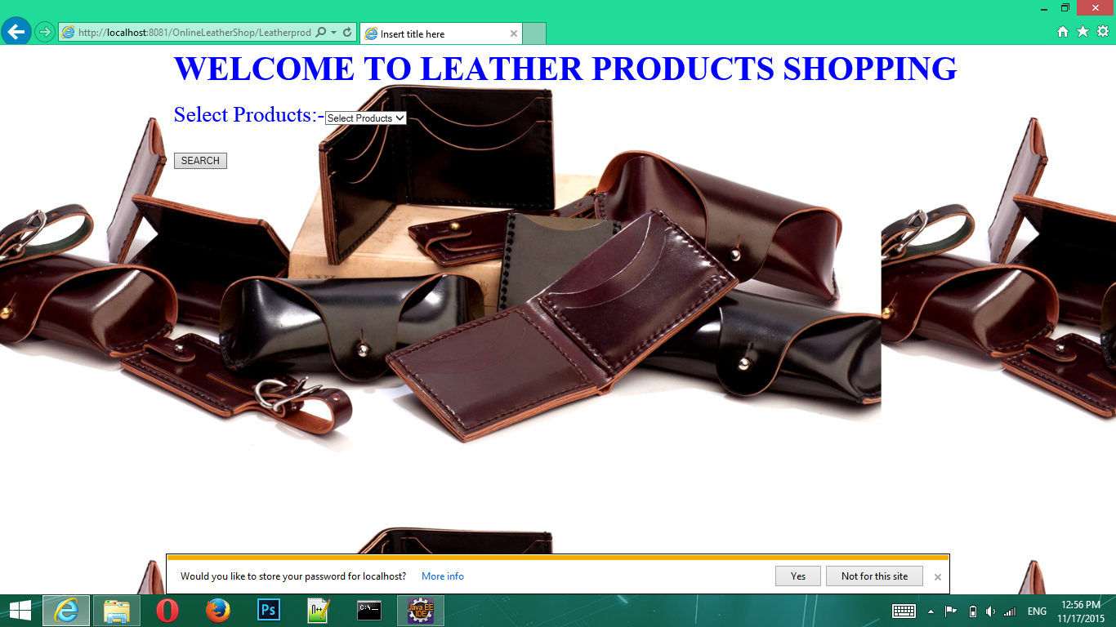

Slide 10
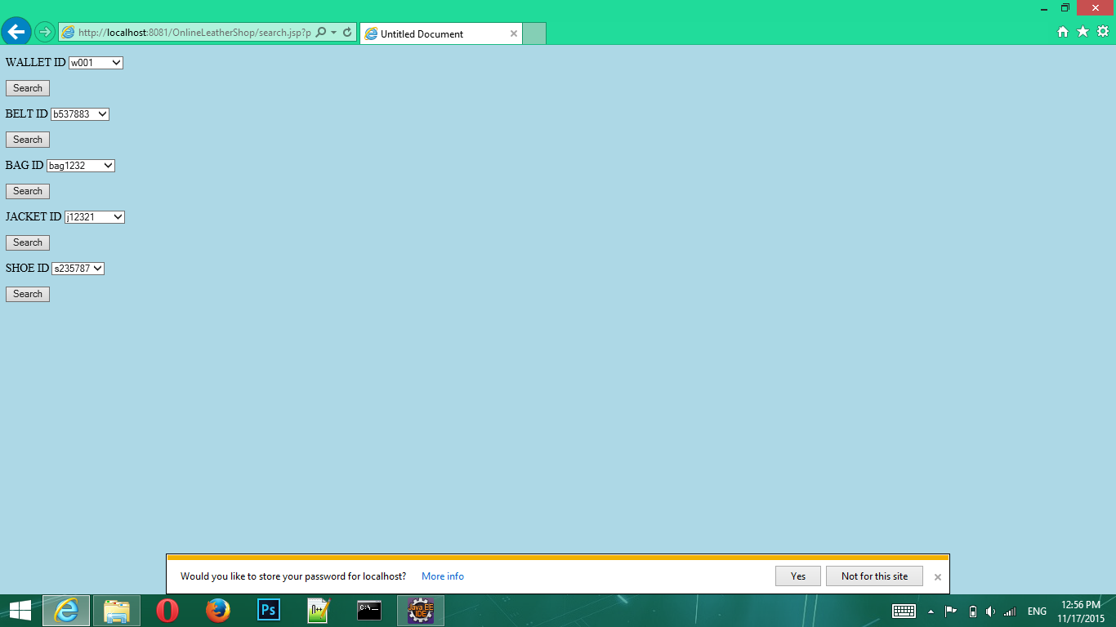

Slide 12
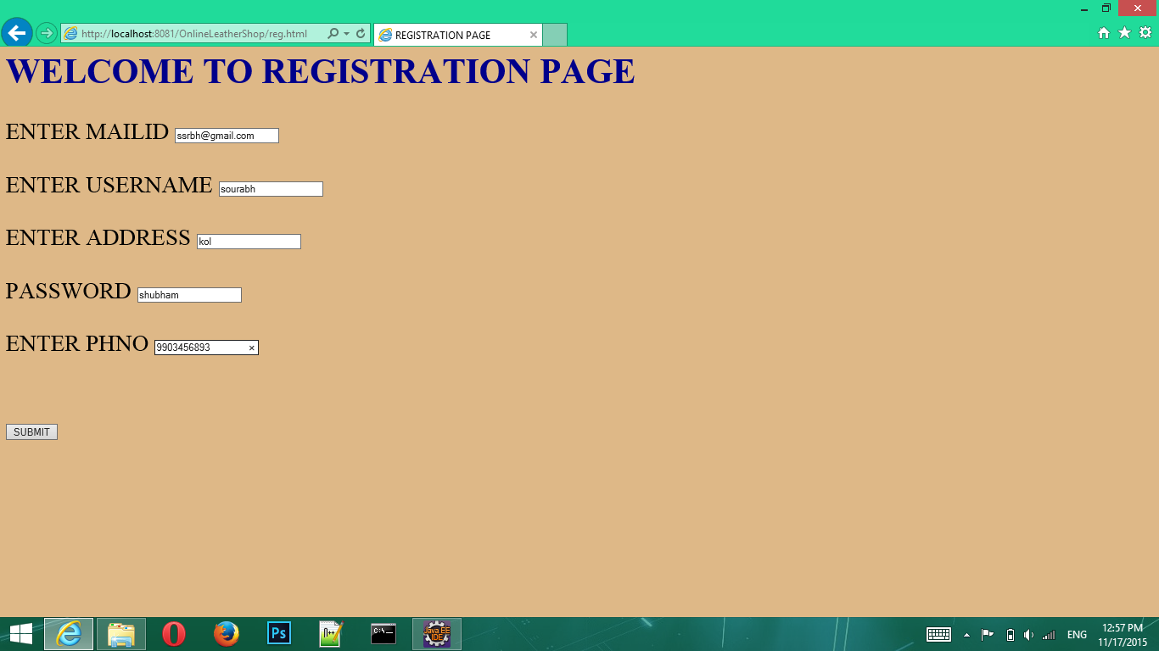

Slide 13
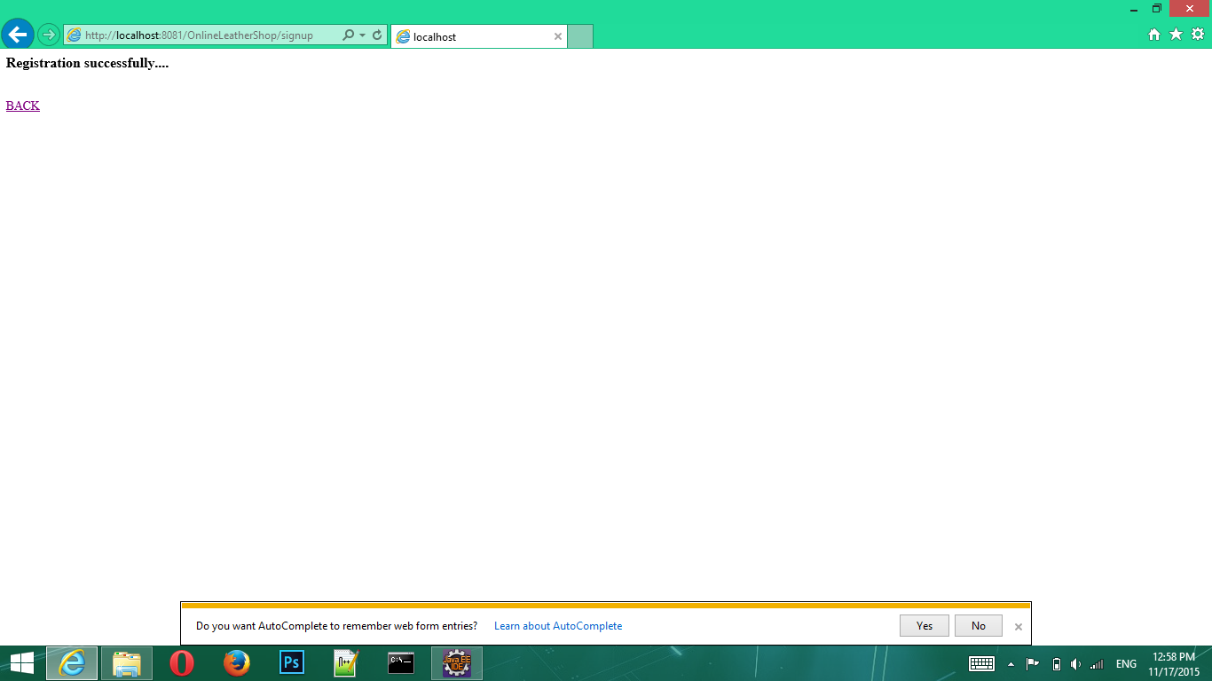

Slide 14

DATBASE STRUCTURE

Slide 15
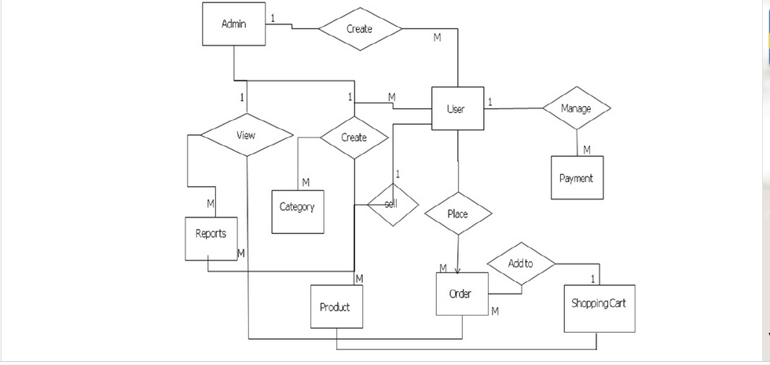
ENTITY RELATIONSHIP DIAGRAM

Slide 16
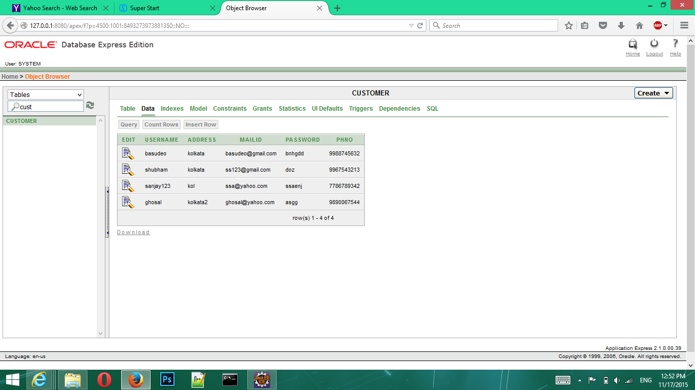

Slide 17
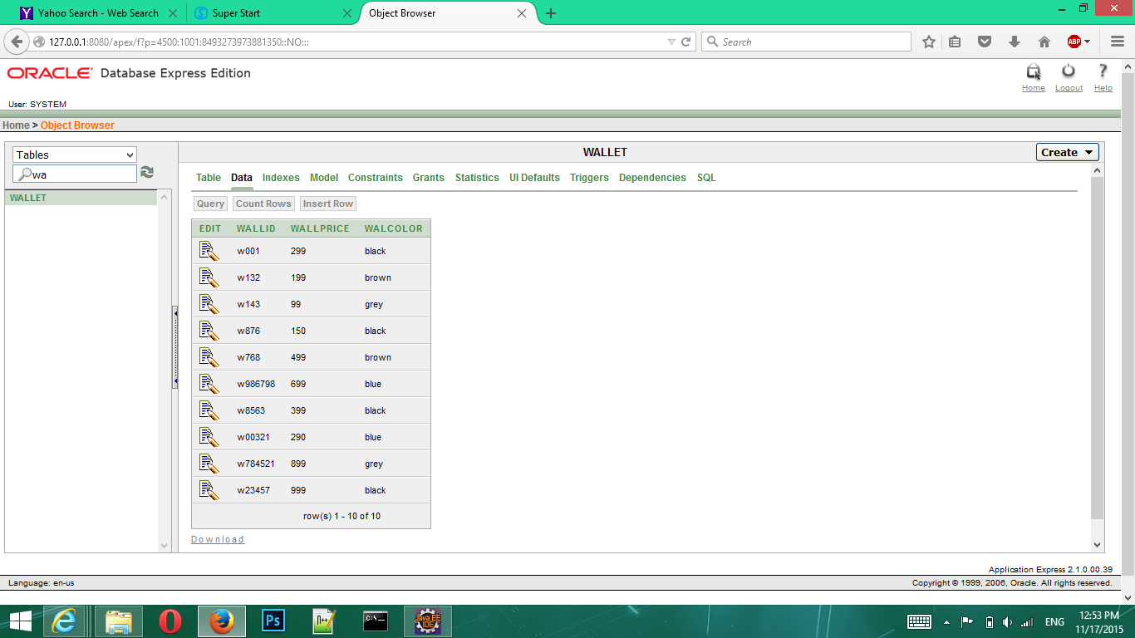

Slide 18
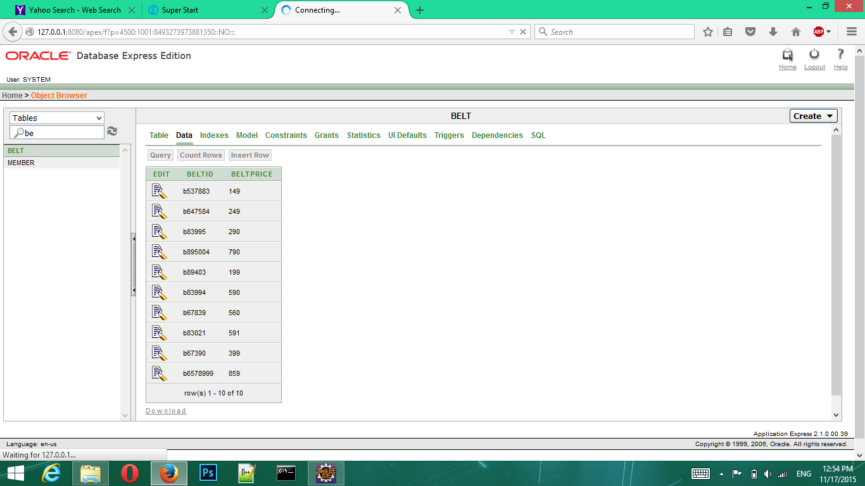

Slide 19
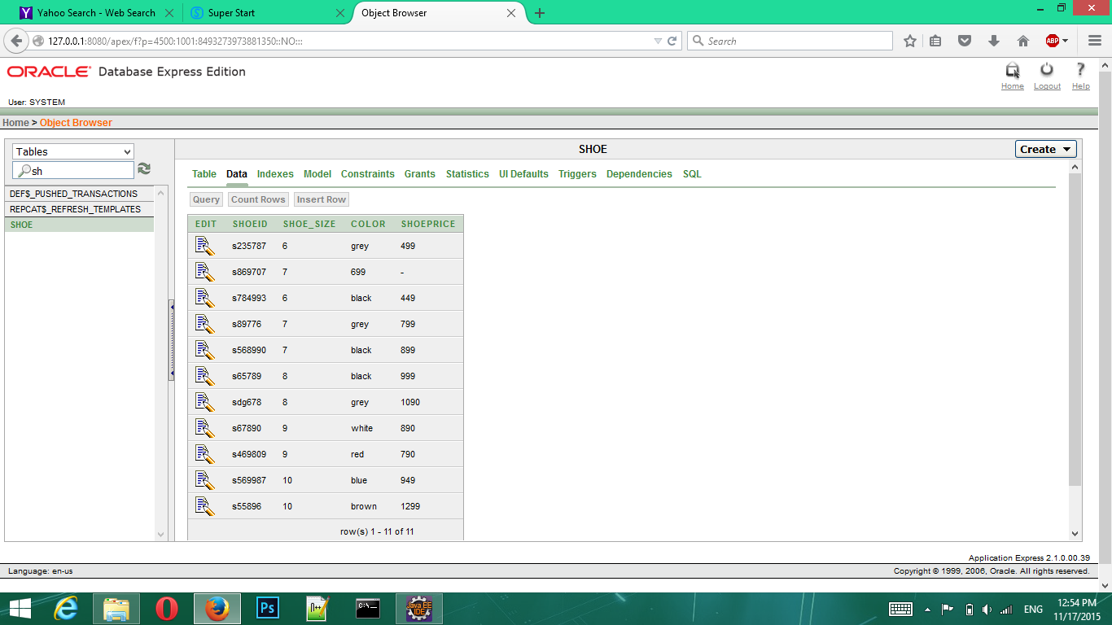

Slide 20
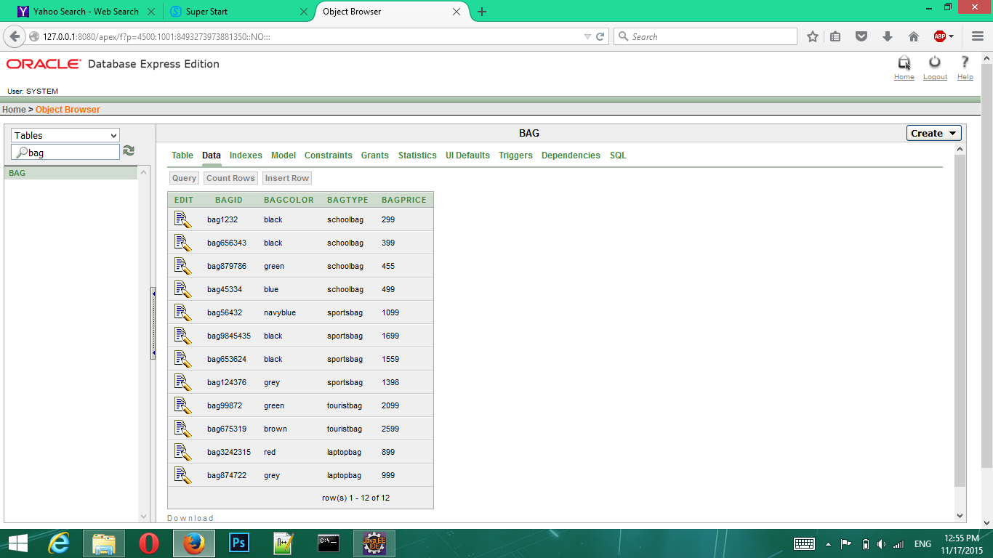

Slide 21
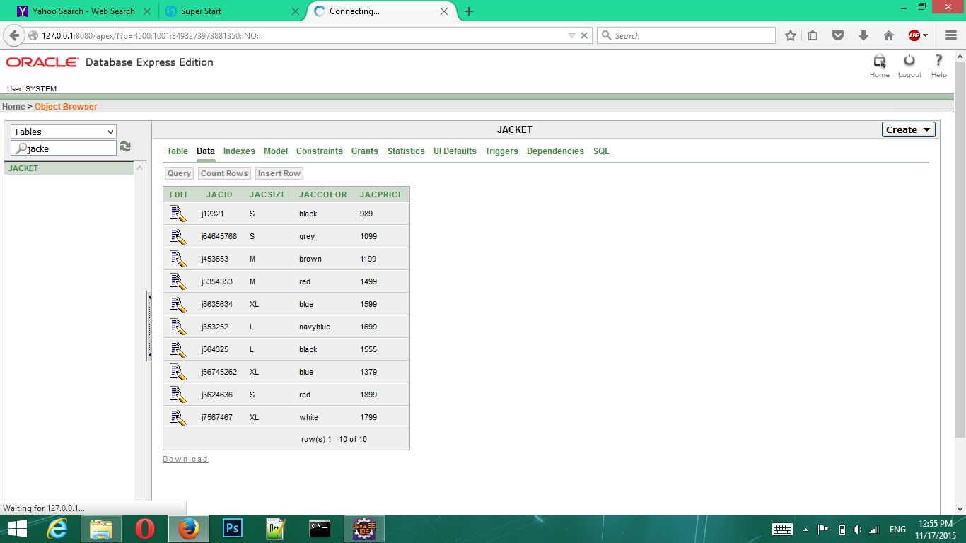

Slide 22
Future scope :
Most generic consumer to consumer e-commerce website , which covers almost all possible categories , with 2 level listing.
Maximize benefits and minimize the disadvantages of a common e-commerce website.
User friendly, Vendor friendly environment.

Slide 23

THANK YOU !

